Slide 1


Predicting Apartment Rentals in Riyadh Using Linear Regression
Presented by Feras Alyahya ,Ahmed Alonaizi ,Hussain Alhadab and Mohammed Alhamoud

Slide 2
Outline :
01
Introduction
02
Data
03
Correlation
04
Result
05
Prediction
06
Conclusion

Slide 3

Introduction
•Problem :
Many of apartments owners struggle to set the optimal price for rent due to their lack of experience in rent prices. We are developing a linear regression model to predict the best prices that fits the specifications and location of the apartment.
•Solution :
In this project, we will develop a linear regression model to predict apartment rent prices according to their characteristics. Which will help the owners to determine the best price.

Slide 4

Data :
We have used Web Scrapping to collect our data and the source was Aqar site and Wekipedia
Data Columns :
PRICE- BED - BATH - LIVING - AGE - IMAGES - FLOOR - TARGET-
FURNISHED - KITCHEN - ANNEXE - PARKING - ELEVATOR - AC

Slide 5
Data cleaning & engineering
Before Data cleaning & engineering
Number of rows = 6978
• Remove empty values
• Remove redundancy
• Remove the outlier values in the (Price) and (BED) columns
• Convert the variable type to numeric
•Add a column with the name (Amanat)
• Add a column with the name (Regions)
After Data cleaning & engineering
Number of rows = 5146

Slide 6
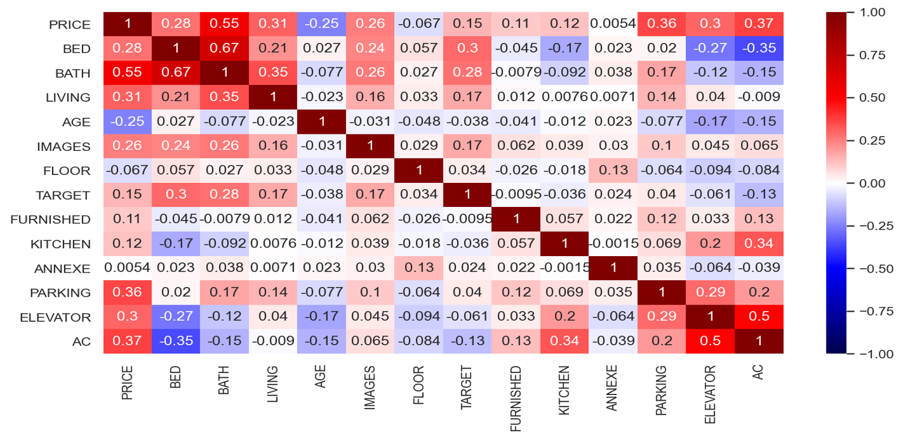
Correlation :

Slide 7


Result
Linear Regression
Ridge Regression
Polynomial Regression
All features
Using Amanat (Baladiat)
Train R^2 = 0.71
Validation R^2 = 0.71
Test R^2 = 0.72
Train R^2 = 0.71
Validation R^2 = 0.71
Test R^2 = 0.72
Train R^2 = 0.83
Validation R^2 = 0.76
Test R^2 = 0.78
X1 =
All features
Using Neighborhoods
Train R^2 = 0.83
Validation R^2 = -4.0
Test R^2 = -4.2
Train R^2 = 0.83
Validation R^2 = -4.0
Test R^2 = -4.2
Train R^2 = 0.91
Validation R^2 = -900
Test R^2 = -800
X2=
All features
Using Regions
Train R^2 = 0.70
Validation R^2 = 0.70
Test R^2 = 0.71
Train R^2 = 0.70
Validation R^2 = 0.70
Test R^2 = 0.71
Train R^2 = 0.78
Validation R^2 = 0.75
Test R^2 = 0.76
X3=
Scaled features
Log10 Price
Using Amanat
Train R^2 = 0.784
Validation R^2 = 0.78
Test R^2 = 0.77
Train R^2 = 0.785
Validation R^2 = 0.78
Test R^2 = 0.71
Train R^2 = 0.82
Validation R^2 = -111
Test R^2 = -087
X4=

Slide 8

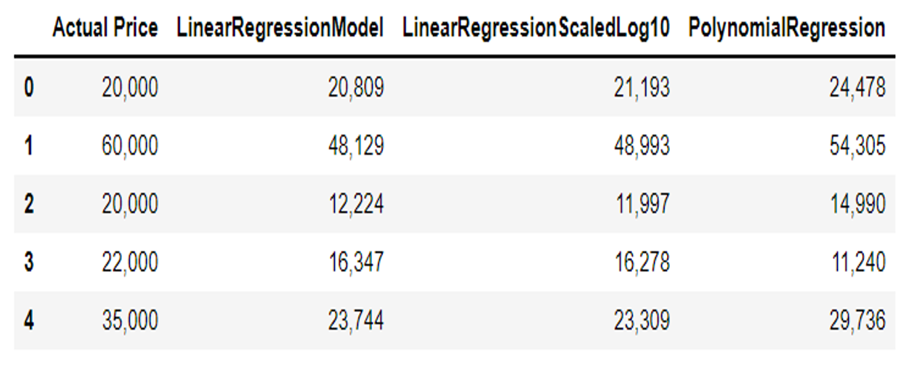
Prediction:

Slide 9

Conclusion
•After the results of the model appeared, and the comparison between the results of each model, we concluded that the best model is the model with the highest R^2.
We seek to improve the accuracy of the model in the future by adding additional features such as the average income of the population in each neighborhood or the number of residents in each neighborhood , which helps us in developing the project and determining the rental prices of apartments based on specifications

